Slide 1
Module-5
Evaluating Model Performance, Improving Model Performance

Slide 2
Evaluating Model Performance
Measuring performance for classification (Evaluation Measure)
1.1. Confusion matrices
1.2. Accuracy
1.3. Precision and recall
1.4. Sensitivity and specificity
1.5. The F-measure
1.6. Visualizing performance
1.6.1. ROC curves
2. Estimating future performance (Evaluation Methods)
2.1. Cross-validation
2.2. Bootstrap sampling

Slide 3
Confusion matrices
A confusion matrix is used to describe the performance of a classification model (or “classifier”) on a set of test data for which the true values are known. A confusion matrix is a table that categorizes predictions according to whether they match the actual value.
Two-class datasets
For a two-class dataset, a confusion matrix is a table with two rows and two columns that reports the number of false positives, false negatives, true positives, and true negatives.
Assume that a classifier is applied to a two-class test dataset for which the true values are known. Let TP denote the number of true positives in the predicted values, TN the number of true negatives, etc. Then the confusion matrix of the predicted values can be represented as follows:

Slide 4
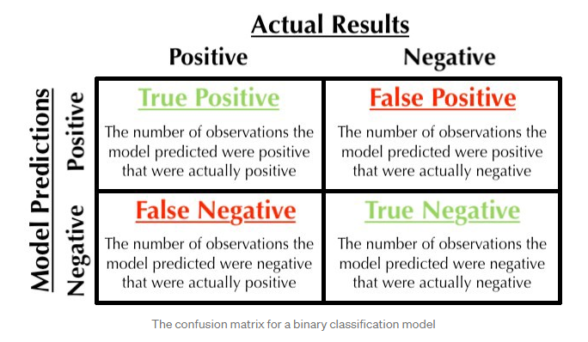

Slide 5
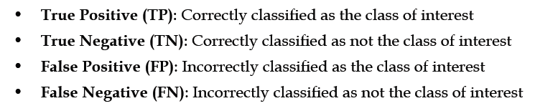
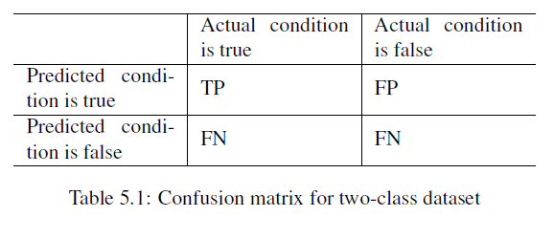

Slide 6
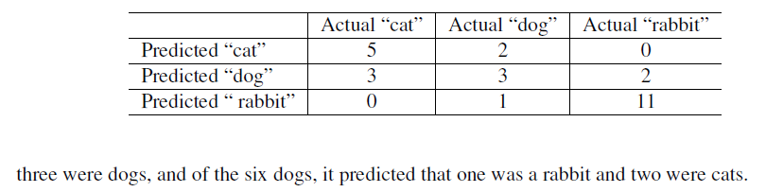
Multiclass datasets
Example
If a classification system has been trained to distinguish between cats, dogs and rabbits, a confusion matrix will summarize the results of testing the algorithm for further inspection. Assuming a sample of 27 animals - 8 cats, 6 dogs, and 13 rabbits, the resulting confusion matrix could look like the table below: This confusion matrix shows that, for example, of the 8 actual cats, the system predicted that

Slide 7

Accuracy
Accuracy is a metric that generally describes how the model performs across all classes.
Accuracy is the ratio of the total number of correct predictions and the total number of predictions.

Slide 8
Precision and recall
The precision is calculated as the ratio between the number of Positive samples correctly classified to the total number of samples classified as Positive (either correctly or incorrectly).
The precision measures the model's accuracy in classifying a sample as positive.
The precision reflects how reliable the model is in classifying samples as Positive.
The goal of the precision is to classify all the Positive samples as Positive, and not misclassify a negative sample as Positive.
The recall is calculated as the ratio between the number of Positive samples correctly classified as Positive to the total number of Positive samples.
The recall measures the model's ability to detect Positive samples.

Slide 9
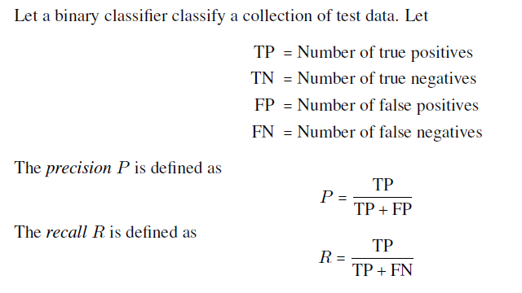

Slide 10
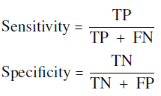
Sensitivity and specificity
The sensitivity of a model (also called the true positive rate), measures the proportion of positive examples that were correctly classified..
The specificity of a model (also called the true negative rate), measures the proportion of negative examples that were correctly classified.

Slide 11

The F-measure
A measure of model performance that combines precision and recall into a single number is known as the F-measure (also sometimes called the F1 score or the F-score). F1-score is the Harmonic mean of the Precision and Recall

Slide 12
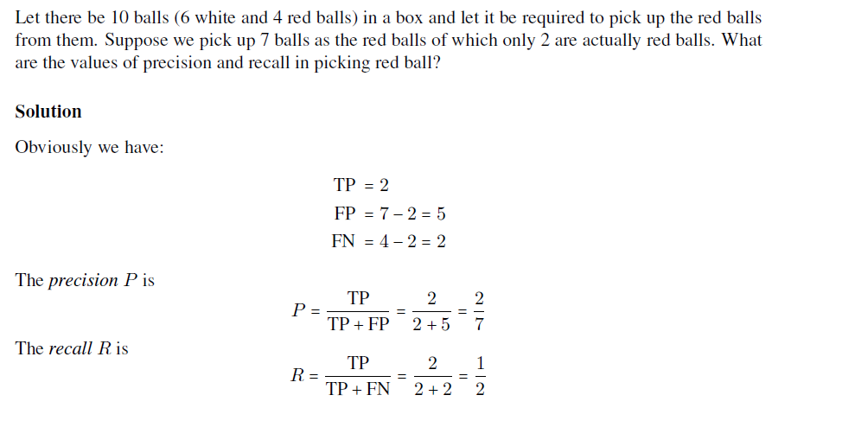
Problem-1

Slide 13
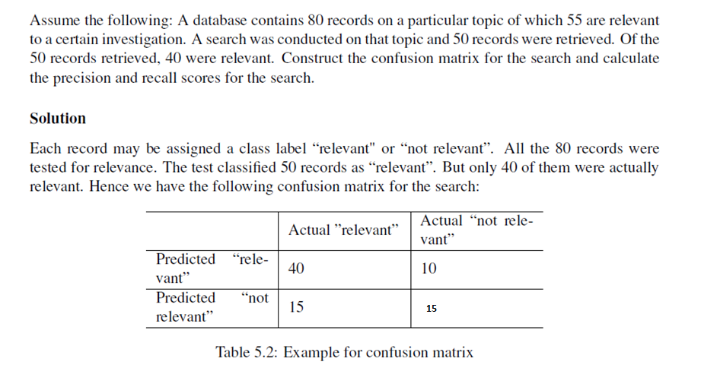
Problem-2

Slide 14
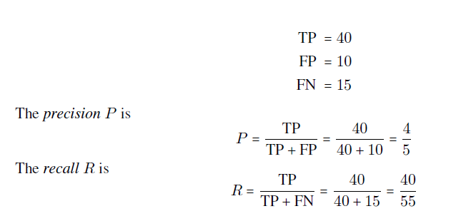

Slide 15
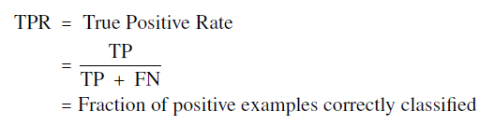
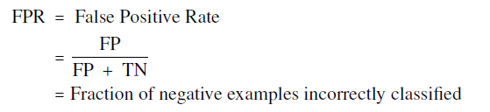
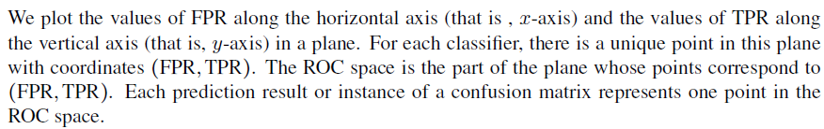
ROC curves(Receiver Operating Characteristic )
The perfect classifier has a curve that passes through the point at 100 percent true positive rate and 0 percent false positive rate. The closer the curve is to the perfect classifier, the better it is at identifying positive values. This can be measured using a statistic known as the area under the ROC curve (abbreviated AUC).

Slide 16
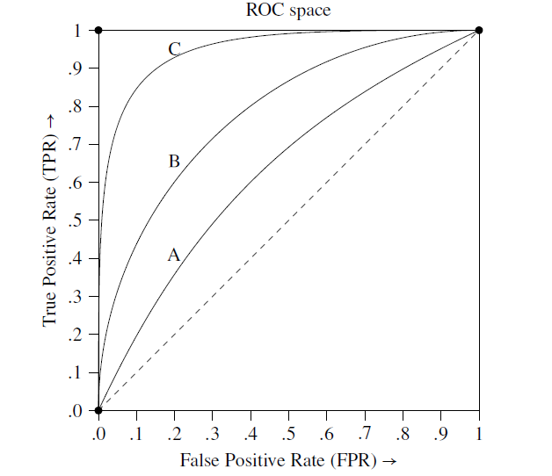
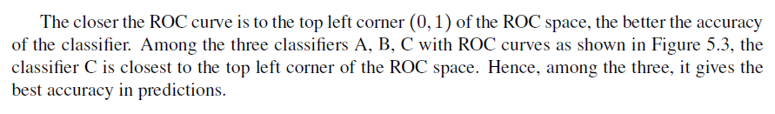
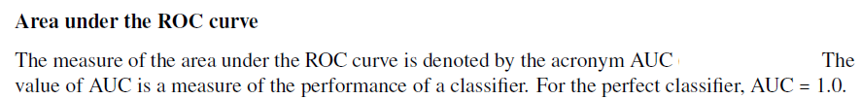

Slide 17
Cross-validation
Cross-validation is a technique to evaluate predictive models by partitioning the original sample into a training set to train the model, and a test set to evaluate it.
K-fold cross-validation
K-Fold CV is where a given data set is split into a K number of sections/folds where each fold is used as a testing set at some point. Lets take the scenario of 5-Fold cross validation(K=5). Here, the data set is split into 5 folds. In the first iteration, the first fold is used to test the model and the rest are used to train the model. In the second iteration, 2nd fold is used as the testing set while the rest serve as the training set. This process is repeated until each fold of the 5 folds have been used as the testing set.

Slide 18
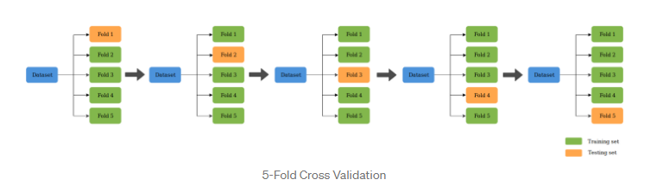

Slide 19
Bootstrap sampling
Bootstrap Sampling is a method that involves drawing of sample data repeatedly with replacement from a data set .
By “with replacement”, we mean that the same data point may be included in our resampled dataset multiple times.
The bootstrap allows examples to be selected multiple times through a process of sampling with replacement.
This means that from the original dataset of n examples, the bootstrap procedure will create one or more new training datasets that also contain n examples, some of which are repeated.
The corresponding test datasets are then constructed from the set of examples that were not selected for the respective training datasets.

Slide 20
Improving Model Performance
Ensemble Methods
1.1. Bagging
1.1.2. Random forests
1.2. Boosting

Slide 21
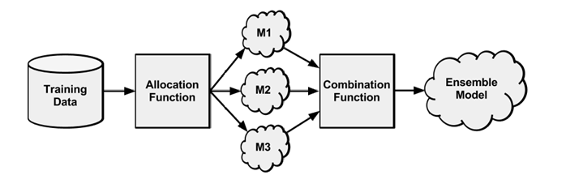
Ensemble Methods

Slide 22
First, input training data is used to build a number of models.
The allocation function dictates whether each model receives the full training dataset or merely a sample.
Since the ideal ensemble includes a diverse set of models, the allocation function could increase diversity by artificially varying the input data to train a variety of learners.
For instance, it might use bootstrap sampling to construct unique training datasets or pass on a different subset of features or examples to each model.
On the other hand, if the ensemble already includes a diverse set of algorithms—such as a neural network, a decision tree, and a kNN classifier—then the allocation function might pass on the data relatively unchanged.
After the models are constructed, they can be used to generate a set of predictions.
The combination function governs how disagreements among the predictions are reconciled.
This process of using the predictions of several models to train a final arbiter model is known as stacking.

Slide 23
Bagging
One of the first ensemble methods to gain widespread acceptance used a technique called bootstrap aggregating, or bagging for short.
Bagging generates a number of training datasets by bootstrap sampling the original training data.
These datasets are then used to generate a set of models using a single learning algorithm.
The models' predictions are combined using voting (for classification) or averaging (for numeric prediction).

Slide 24
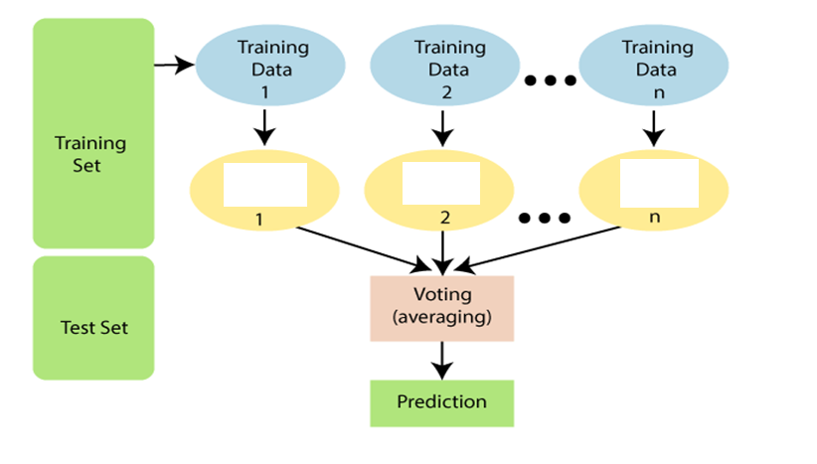
Model
Model
Model

Slide 25
Boosting
Another popular ensemble-based method is called boosting, because it boosts the performance of weak learners to attain the performance of stronger learners.
Similar to bagging, boosting uses ensembles of models trained on resampled data and a vote to determine the final prediction.
The key difference is that the resampled datasets in boosting are constructed specifically to generate complementary learners, and the vote is weighted based on each model's performance rather than giving each an equal vote.
How Boosting works?
step 1: The base learner takes all the distributions and assign equal weight or attention to each observation.
Step 2: If there is any prediction error caused by first base learning algorithm, then we pay higher attention to observations having prediction error. Then, we apply the next base learning algorithm.
Step 3: Iterate Step 2 till the limit of base learning algorithm is reached or higher accuracy is achieved.
Finally, it combines the outputs from weak learner and creates a strong learner which eventually improves the prediction power of the model. Boosting pays higher focus on examples which are mis-classiﬁed or have higher errors by preceding weak rules.

Slide 26
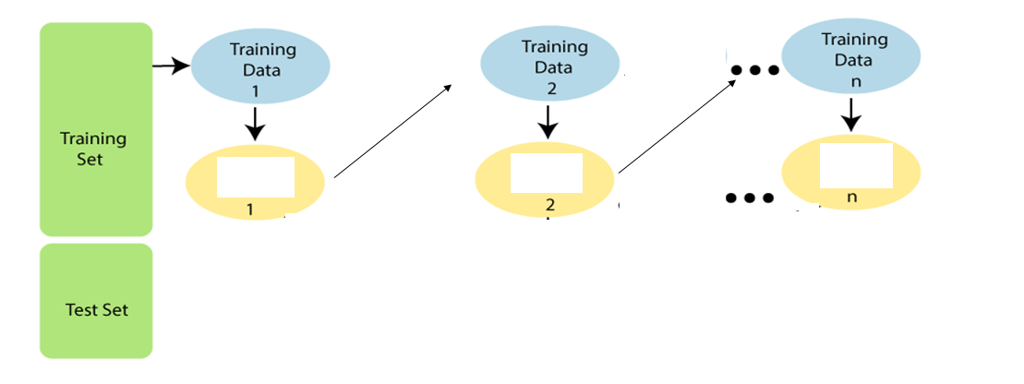
More weights to predicted error data
More weights to predicted error data
Model
Model
Model

Slide 27
Random Forests
Random Forest is a classifier that contains a number of decision trees on various subsets of the given dataset and takes the average to improve the predictive accuracy of that dataset.
Random Forest works in two-phase first is to create the random forest by combining N decision tree, and second is to make predictions for each tree created in the first phase.
The Working process can be explained in the below steps and diagram:
Step-1: Select random K data points from the training set.
Step-2: Build the decision trees associated with the selected data points (Subsets).
Step-3: Choose the number N for decision trees that you want to build.
Step-4: Repeat Step 1 & 2.
Step-5: For new data points, find the predictions of each decision tree, and assign the new data points to the category that wins the majority votes.

Slide 28
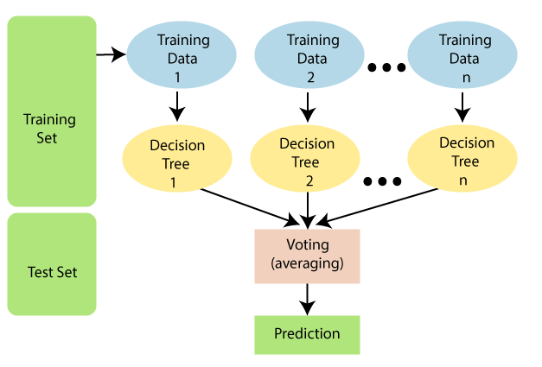

Slide 29
Example: Suppose there is a dataset that contains multiple fruit images. So, this dataset is given to the Random forest classifier. The dataset is divided into subsets and given to each decision tree. During the training phase, each decision tree produces a prediction result, and when a new data point occurs, then based on the majority of results, the Random Forest classifier predicts the final decision. Consider the below image:

Slide 30


